Slide 1


Slide 2
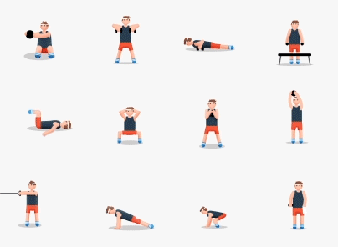

Slide 3


Slide 4
CIRCULATORY SYSTEM
CLASS V

Slide 5
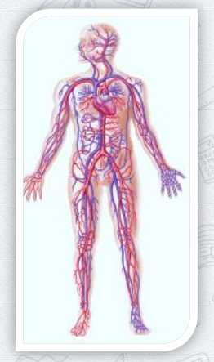
Circulatory system is made up of:
Heart
Blood
Blood vessls
It carries oxygen and nutrients to the cell and removes waste products like carbon dioxide.

Slide 6
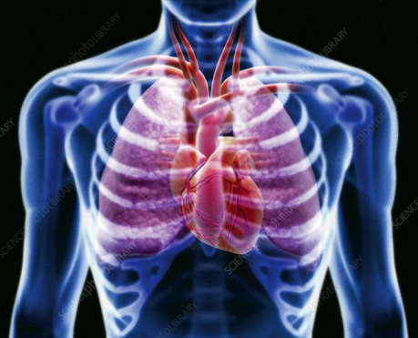
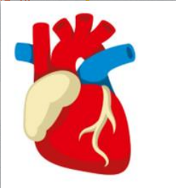
HEART
Heart is located in the middle of the chest cavity and protected by rib cage. In humans, it is about the size of a fist.

Slide 7
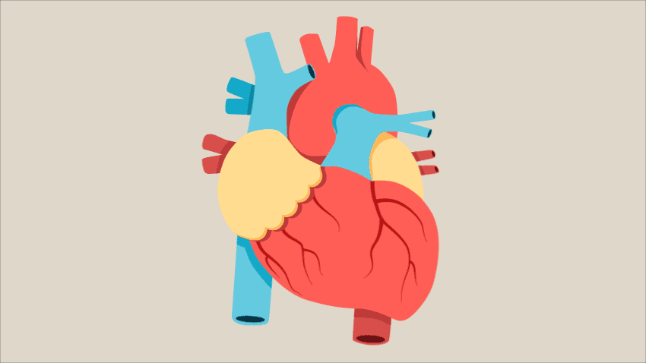
The Heart is one of the most important organs in the human body. It is made up of special muscles called cardiac muscles.
The right side of the heart receives the blood from the body and pumps it to the lungs.
The left side of the heart receives blood from the lungs and pumps it all the parts of the body

Slide 8
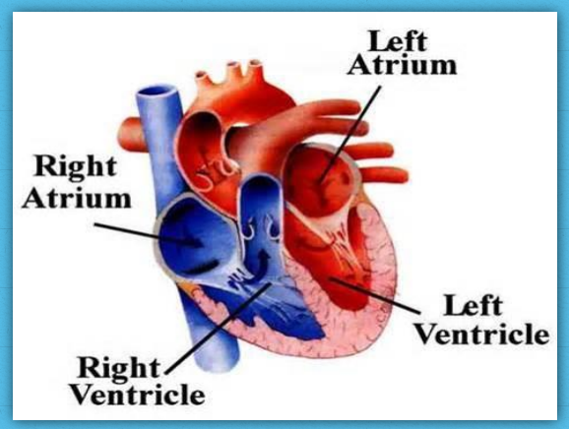

Slide 9
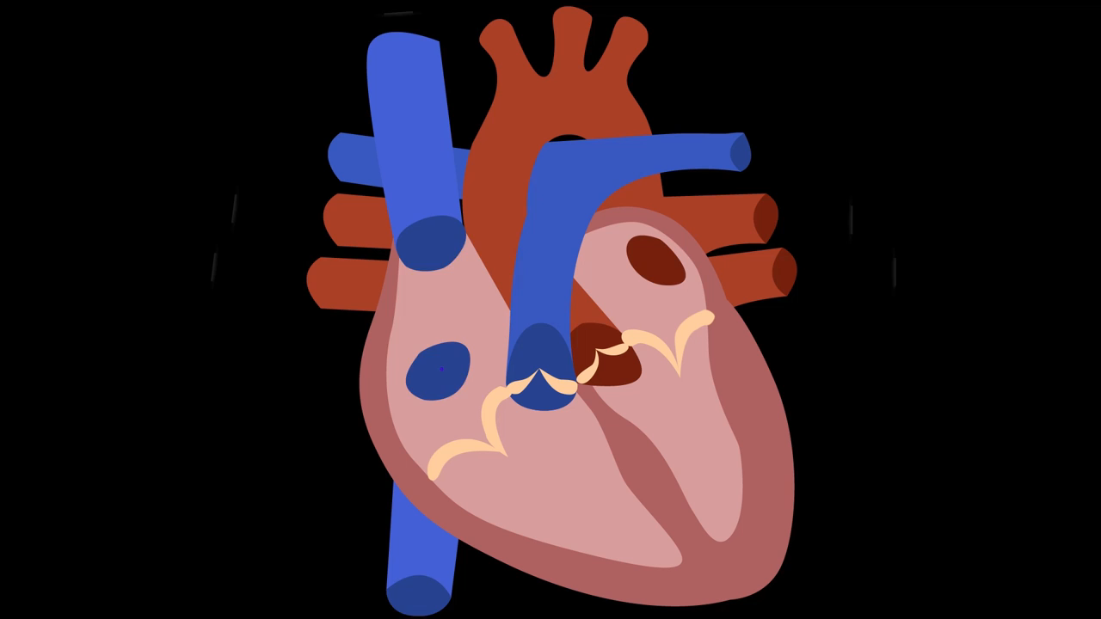

Slide 10
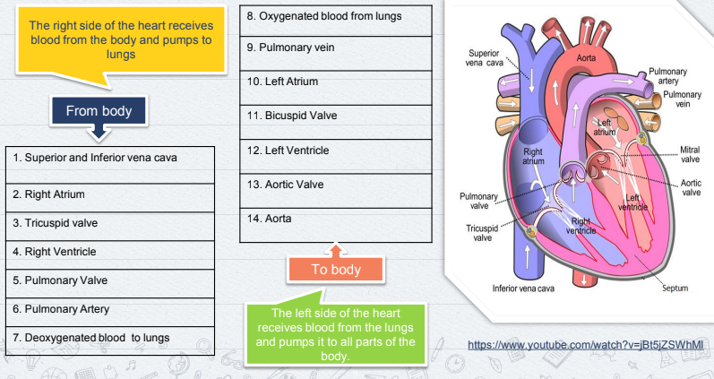
Pulmonary circulation
Vein
Systemic circulation

Slide 11
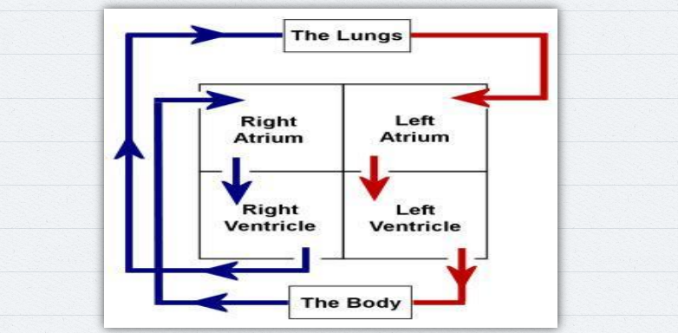

Slide 12
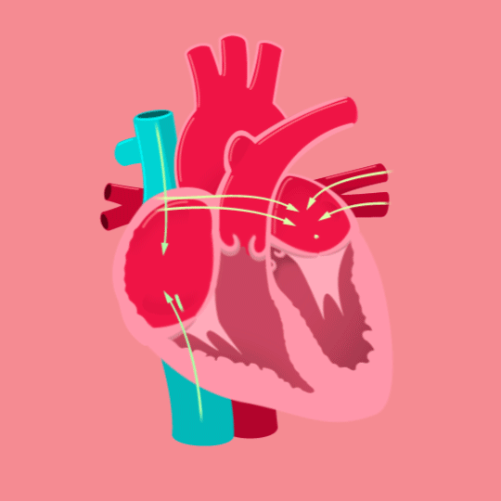
aorta
superior vena cava
Pulmonary artery
Pulmonary vein
left atrium
right atrium
right ventricle
left ventricle
Inferior vena cava
Cardiac muscle

Slide 13
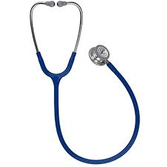
Pulse Rate or Heart Rate
The number of times the heart beats in a minute is called Pulse rate or Heart rate.
Unit to measure heart rate is beats per minute (BPM)
A normal resting heart rate for adults ranges from 60 to 100 beats per minute (for children: 70-100 beats per minute).

Slide 14
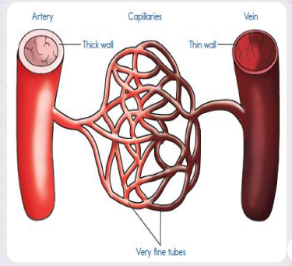
BLOOD VESSELS
Blood vessels are a network of hollow tubes that transport blood all over our body.
There are three major types of blood vessels:
✘ Arteries
✘ Veins
✘ Capillaries

Slide 15
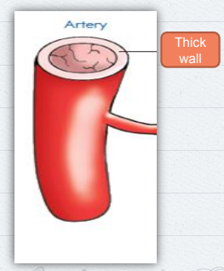
ARTERIES
Arteries carry oxygenated blood from the heart to the various parts of the body.
Arteries carry oxygenated blood away from heart.
They have thick elastic wall.
Pulmonary artery is the only artery which carry deoxygenated blood.
Valves are not present

Slide 16
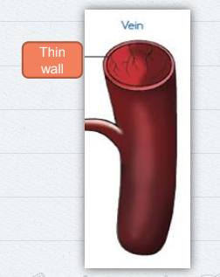
VEINS
Veins bring deoxygenated blood from the various parts of the body to the heart.
Veins carry deoxygenated blood towards heart.
They have thin walls
Pulmonary vein is the only vein that carry oxygenated blood.
Valves are present.

Slide 17
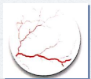
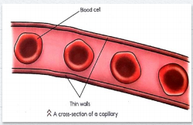
Capillaries
Capillaries are the smallest blood vessel.
They connect veins to arteries.
They have walls thinner than veins.
They allow nutrients from digested food, oxygen and water to pass easily into the cells.
Carbon dioxide and other waste materials are also exchanged through the thin walls of the capillaries.

Slide 18
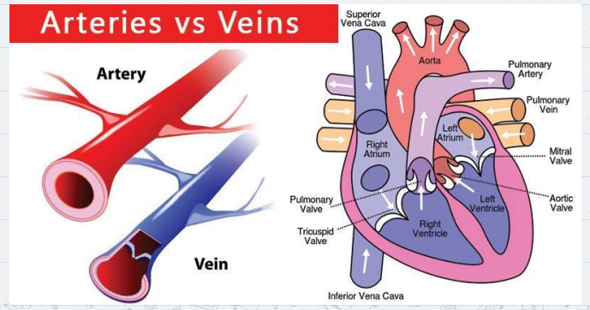

Slide 19
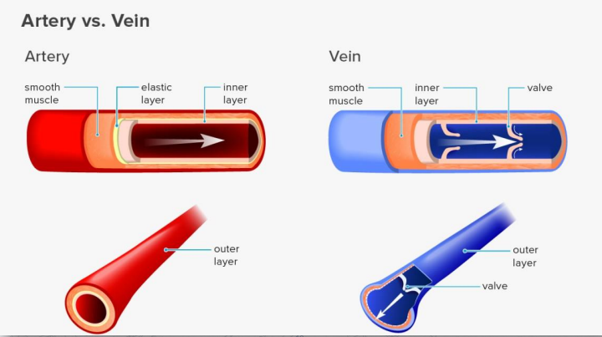

Slide 20
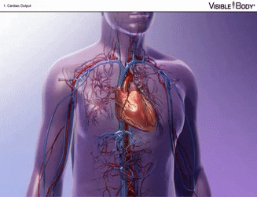

Slide 21
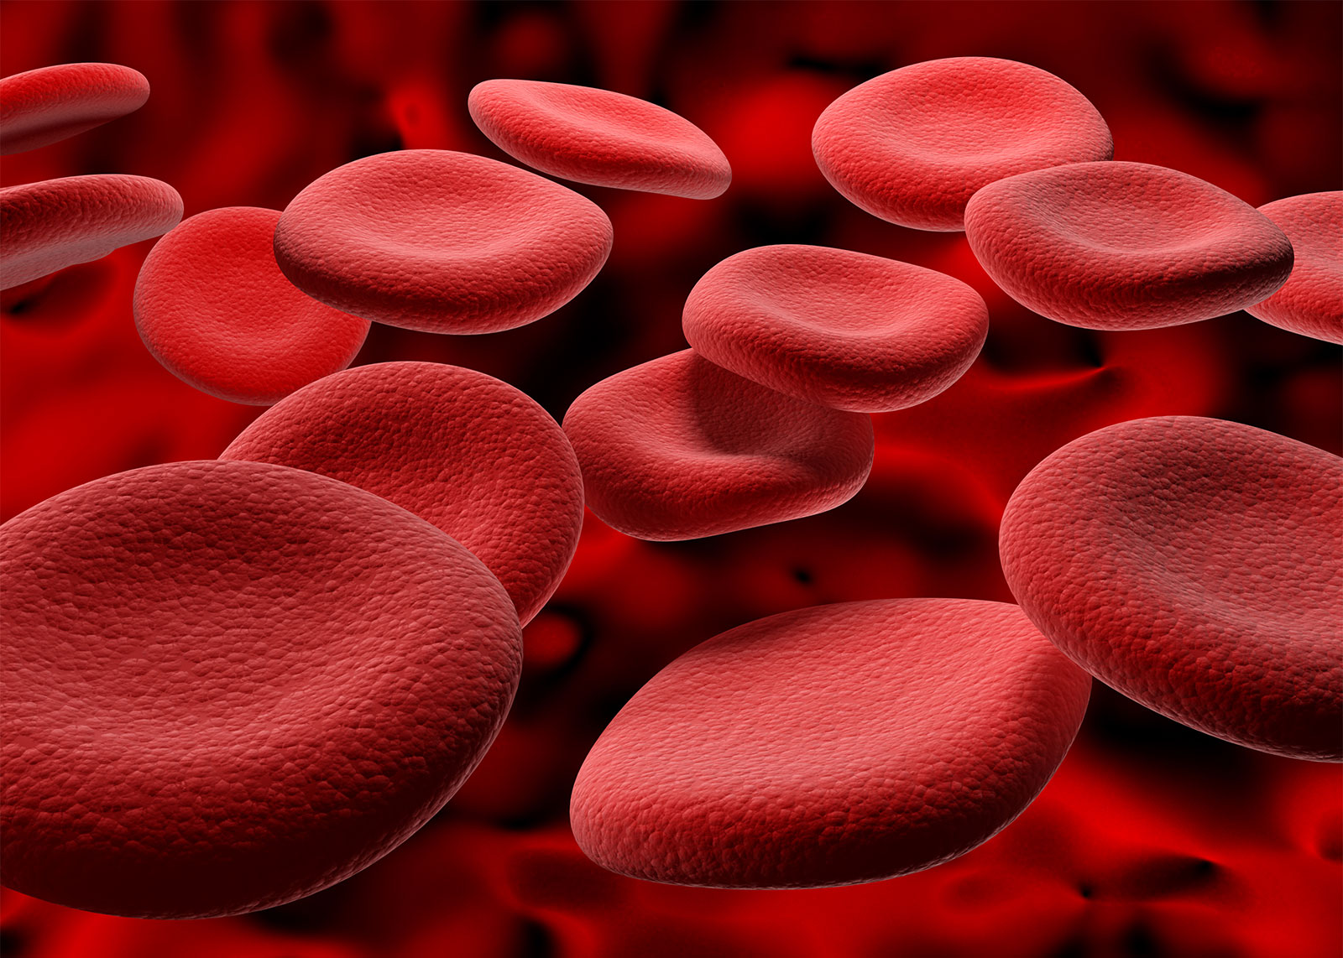
One of the main functions is to supply oxygen and nutrients to the cells in our body.
It also removes waste such as carbon dioxide from them.
It keeps our body temperature constant.
Blood lacking in oxygen is dark red in colour not blue.
BLOOD

Slide 22
What is the circulatory system?
the body’s breathing system
the body’s food-processing system
the body’s blood-transporting system

Slide 23
What is the main function of the circulatory system?
To control the blood flow around the body
To supply blood to the body
To help us to breathe

Slide 24

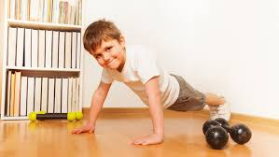
We should take care of our heart by eating right food and doing regular exercise.

Slide 25
RECAP
Heart is the muscular organ that pumps blood to the various parts of the body.
Arteries carry oxygenated blood from the heart to the various parts of the body.

Slide 26
RECAP
Veins bring deoxygenated blood from the various parts of the body to the heart.
We should take care of our heart by eating right food.
We should take care of our heart by doing regular exercise.

Slide 27
MEMORY MAP
The circulatory system is made up of
Heart and blood vessels
The heart keeps pumping the blood
Blood vessels carry oxygen, nutrients and
When we run or play
pump blood throughout the body
carbon dioxide
the heart beat increases
even when we are sleeping
the heart and blood vessels

Slide 28
DRAG AND DROP
Heart | Veins | Arteries
Size of the fist
Carries deoxygenated blood
Carries oxygenated blood
Reddish brown in colour
Carries pure blood from the heart
Carries impure blood to the heart
Pumps blood
Supplies to all parts of the body
Carries nutrients
Carries nutrients
Carries impure blood to the heart
Carries deoxygenated blood
Carries oxygenated blood
Carries pure blood from the heart
Supplies to all parts of the body
Size of the fist
Reddish brown in colour
Pumps blood

Slide 29
CIRCULATORY SYSTEM
Heart
Blood vessels
Kinds of blood vessels
Arteries
Veins
Oxygenated blood
Deoxygenated blood

Slide 30


Slide 31


